Slide 1







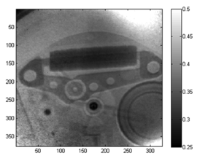
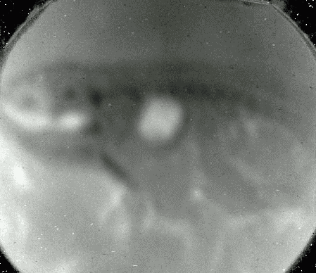
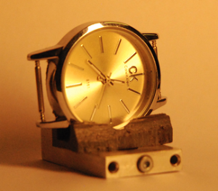
Proton radiography for stereotactic particle radiosurgery .
Kantsyrev Alexey
Institute for Theoretical and Experimental Physics NRC KI,
Moscow, Russia
2015

Slide 2
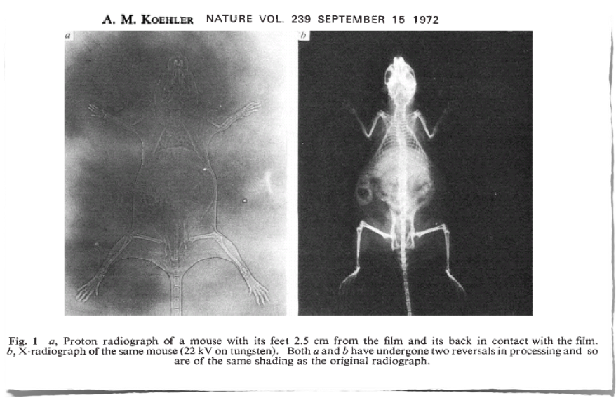
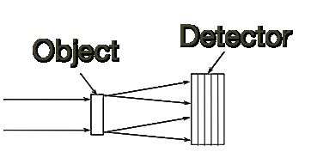
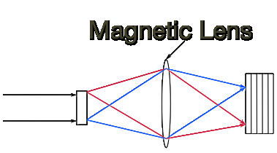
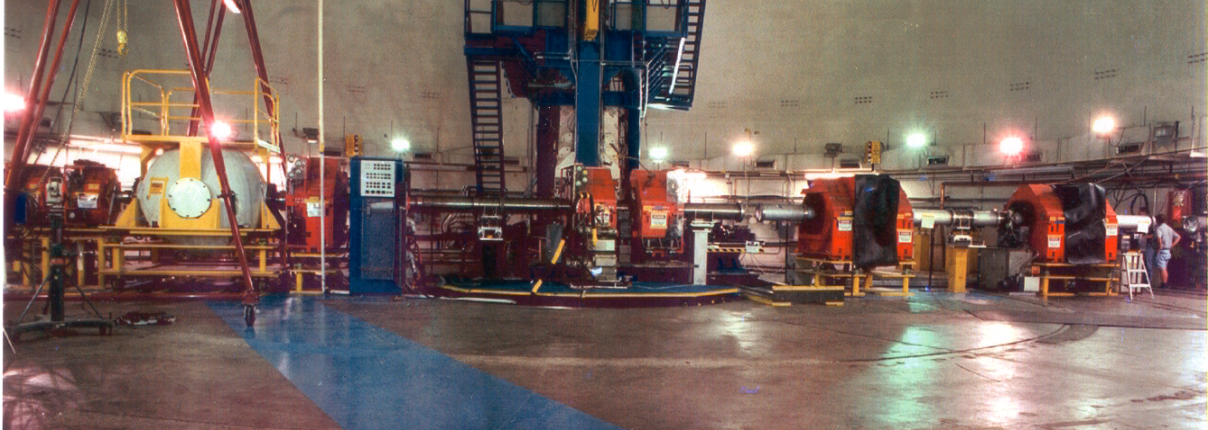

History of Proton Radiography
Early proton radiography: scattering radiography
edge detection only
(no density reconstruction)
limited to thin objects
Image at the detector is substantially
blurred due to MCS (1968)
First High energy proton radiography setup with magnetic optics setup LANL pRad setup:
Proton beam energy – 800 MeV
Magnification – 7
Spatial resolution ~ 200, 65, 35 µm
Field of view – 120, 44, 17 mm
Magnetic imaging lens preserves the image in high resolution (LANSCE 1997)
Notes:
Fi

Slide 3
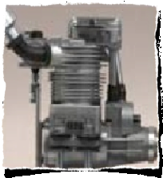
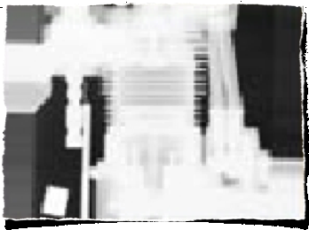
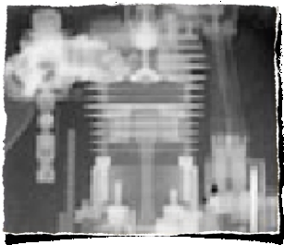
High energy proton radiography = target density diagnostic
Advantages of GeV proton radiography over X-Ray:
large penetrating depth
(eight times more than X-Ray (4 MeV))
aberrations correction by magnets
high spatial resolution (magnification = proton microscopy)
high density resolution and dynamic range
multi-frame capability for fast dynamic events
Photo
100 keV X-rays
800 MeV protons
Notes:
Existing proton radiography facilities in U.S. and in Russian clearly showed advantage of the proton radiography compared with conventional X-ray methods, under study of dense objects, especially in dynamic experiments. The best spatial resolution of the method for proton radiography was obtained at facilities with increasing image of the objects, constructed according to the scheme of the proton microscope. Quadrupole lenses based on permanents magnets (PMQ) with high gradient magnetic field and small geometric dimensions are used to create such facilities.

Slide 4
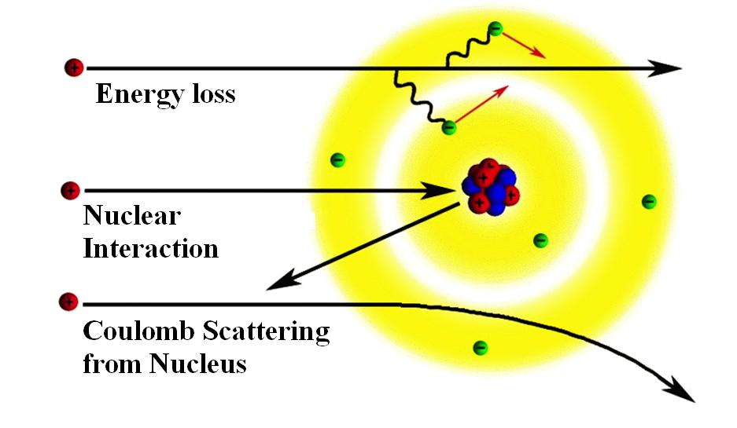
Transmission of the beam
Interaction of proton with matter
λ_{c} – nuclear length,
x₀ – radiation length,
x – areal density,
θ_{с} – angular acceptance
of the setup
p – momentum of beam
Transmission = information
about density distribution
Notes:
Existing proton radiography facilities in U.S. and in Russian clearly showed advantage of the proton radiography compared with conventional X-ray methods, under study of dense objects, especially in dynamic experiments. The best spatial resolution of the method for proton radiography was obtained at facilities with increasing image of the objects, constructed according to the scheme of the proton microscope. Quadrupole lenses based on permanents magnets (PMQ) with high gradient magnetic field and small geometric dimensions are used to create such facilities.

Slide 5
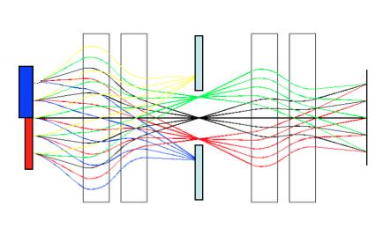
Ion optical scheme of proton radiography setup
Imaging section
Matching section
Object
Image
plane
Proton
beam
Fourie
plane (collimator – provide tune of angular acceptance θ_{с})
Transmission = information about density distribution
Notes:
Existing proton radiography facilities in U.S. and in Russian clearly showed advantage of the proton radiography compared with conventional X-ray methods, under study of dense objects, especially in dynamic experiments. The best spatial resolution of the method for proton radiography was obtained at facilities with increasing image of the objects, constructed according to the scheme of the proton microscope. Quadrupole lenses based on permanents magnets (PMQ) with high gradient magnetic field and small geometric dimensions are used to create such facilities.

Slide 6
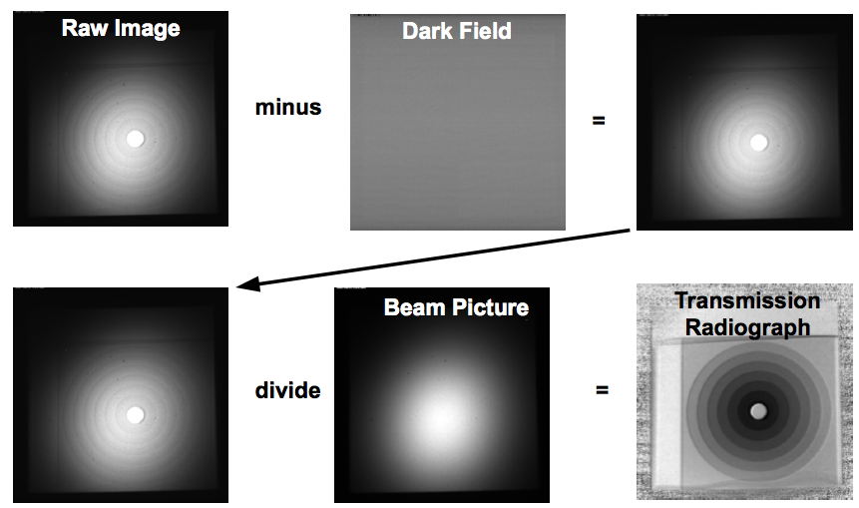
Images processing

Slide 7
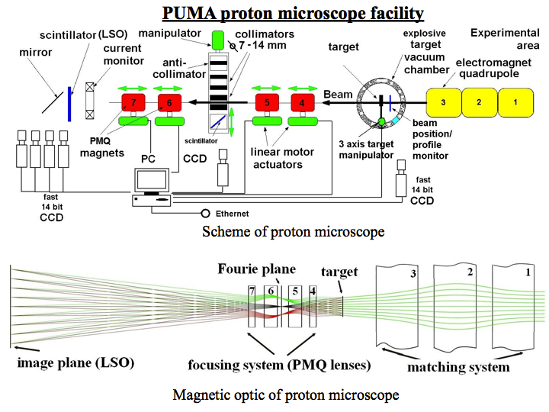
Field of view – 20 mm
Spat. Res - 60 µm
(magnification -4)
A.V. Kantsyrev et al., TWAC-ITEP PROTON MICROSCOPY FACILITY;
Instruments and Experimental Techniques, In print ,2014
Notes:
Proton microscope PUMA was developed at the fast extraction beam line of TWAC-ITEP accelerator. The scheme of the magnetic optics of PUMA proton microscope is a system of seven quadrupole magnetic lenses. Three electromagnetic quadrupole lenses (figure, number 1-3, type-ML-15, 0.9m long, 0.15m aperture) provide the optimal parameters (size and angular characteristics) of the proton beam in the plane of the studied object and partially compensate for aberrations of proton radiographic images. In order to magnify the images of the investigated object, it uses the system of four PMQ quadrupole lenses (figure , number 4-7, 0.04 m aperture, 0.16 and 0.32 m lengths). Turning on of this system is done by longitudinal movement of PMQ lenses. Between the second and third PMQ lenses (figure, number 5,6), a collimator is installed, which is used to increase the contrast of the radiographic images. Fourier plane is formed in the plane of the collimator. In this plane, protons with different scattering angles in the object are separated. The arrangement of the magneto-optic elements of PUMA proton microscope and the trajectory of proton beam are shown on figure.

Slide 8
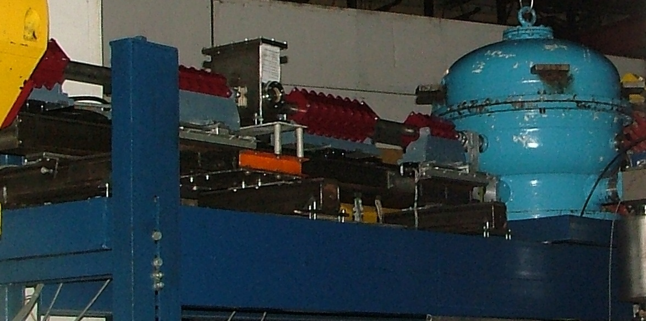
PUMA Proton Microscope at ITEP (Russia)
Parameters:
Proton beam energy – 800 MeV
Target areal density – up to 20 g/cm²
Magnification – 4
Spatial resolution – 60 µm (area density 0.46 g/cm²)
115 µm (area density 17 g/cm²)
Density resolution – up to 5%
Temporal resolution – 47 ns
Field of view – 20 mm

Slide 9
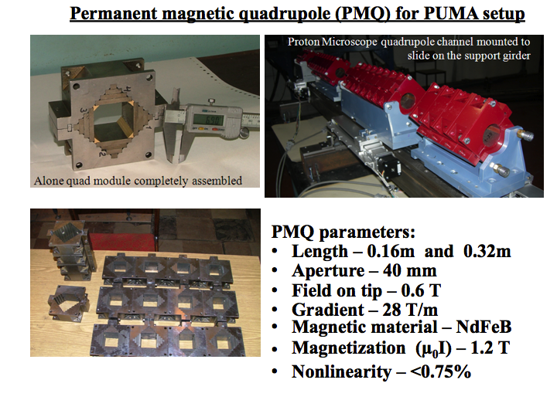
Notes:
Quadrupole lenses on permanent magnets that are used in the imaging system have the following parameters: length of lens 4 and 7 - 160 mm, two internal lenses 5 and 6 - 320 mm, the aperture - 40 mm, the magnetic field on the pole - 0.6 T. Permanent magnetic quadrupole lenses consist of sets of identical quadrupole modules. Each module consist of a set of permanent magnetic elements (Nd-Fe-B), with the length of one module being 40 mm. The permanent magnets are installed in the yoke of soft iron. Given the design of the vacuum system, aperture of the proton microscope is 32 mm (see the figure 3 bottom). The value of the magnetic field at the pole of PMQ is 0.578 T, the field gradient of lens G = 28 T / m, the integral of the gradient I_{G} = 2.3 T.

Slide 10
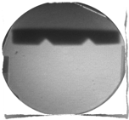
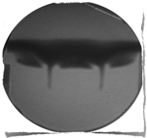
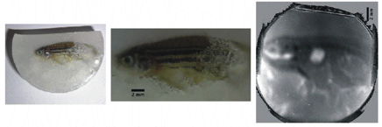
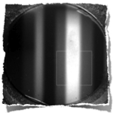
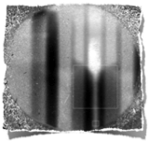
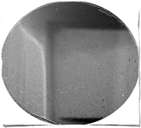
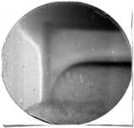
Proton microscopy for high energy density in matter physics, material sciences and beyond
Dynamic fracture and surface ejecta formation in metal under shock loading
Static Dynamic
materials in extremes (EOS, dynamic phase transitions, hydrodynamics of HED flows, instabilities, material strength and damage, ...)
new materials synthesis and process-aware manufacturing
biophysics, medical applications industrial applications
Phase transition of molecular nitrogen
(IPCP, ITEP)
Biologically samples
Static Dynamic
Tomography reconstruction of inner structure of static objects (ITEP)
Non ideal plasma of shock compressed noble gas (Xe)
Static Dynamic

Slide 11
PRIOR (Proton microscope for FAIR, Germany )
Main parameters:
proton energy: up to 4.5 GeV (at GSI), up to 10 GeV (at FAIR) ;
areal density of target: up to 100 g/cm²;
areal density reconstruction: sub-percent level;
spatial resolution: less than 10 μm;
temporal resolution: 10 ns;
multi-framing capability: up to 4 frames per
dynamic event (at GSI), 16 frames at FAIR ;
field of view: 10 – 15 mm;
length of setup ~ 25 m
proton beam intensity: 5*10¹⁰ (at GSI),
2.5*10¹³ (at FAIR)
chromatic length: ~3 m
Notes:
In the first half of 2013 was implemented assembly of the basic elements the PRIOR setup . PMQ lens were set (via adjusting stends) on single rail, which in turn is mounted on support bar attached to the support. Assembled proton microscope mounted on the axis of the proton beam at HHT (GSI) experimental area.

Slide 12
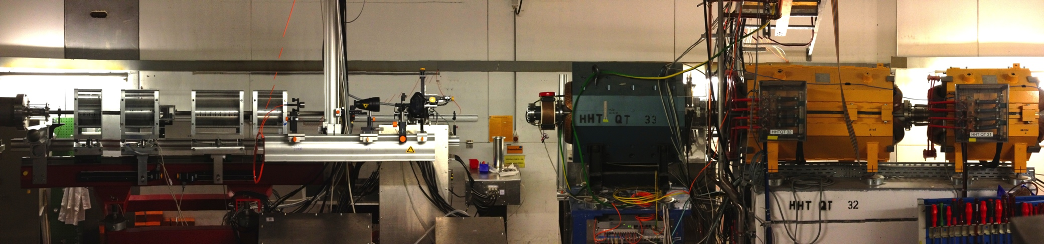
Prototype of PRIOR at HHT experimental area at GSI
Matching section
proton beam direction
Magnifying/imaging section
Notes:
A prototype of PRIOR, was developed at SIS-18 accelerator at GSI (Darmstadt, Germany). PRIOR setup is designed for measurement, with high spatial resolution, of density distribution of static and dynamic objects by using a proton beam with energy up to 4.5 GeV. The aim of this work is to development, assembling and commissioning of the prototype of PRIOR at HHT experimental area of GSI. The magnetic system of the PRIOR beam-line consists of two sections. The first, matching section, contains electromagnetic-quadruple lenses and provides formation of a proton beam for the objects imaging task (beam size, angular distribution). The second section is a magnification section (K ~4) that consists of four Permanent Magnet Quadruples (PMQ) lenses. Tungsten collimators, installed at central plane of magnification section, provides regulation of contrast of the proton-radiographic images. Investigated object installed between first and second section.

Slide 13
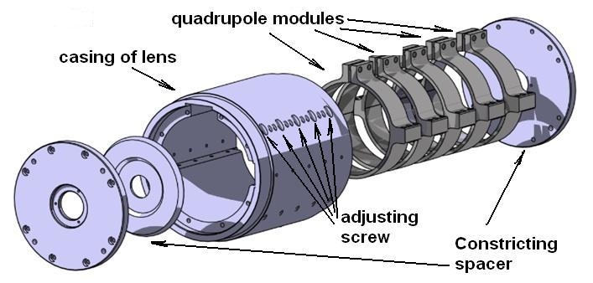
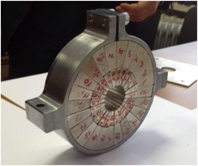
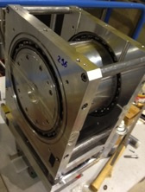
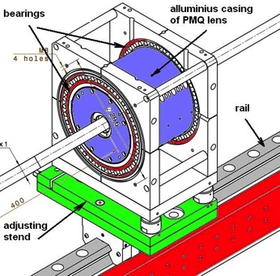
Permanent magnet quadrupole lenses (PMQ) for PRIOR prototype
Al
One quadrupole module
in metal case
Main parameters of PMQ lenses:
PMQ quantity: 4
Pole tip field: 1.83 T
Field gradient: 122 T/m
Nonlinearity: <0.9%
Two layer structure with trapezoidal sectors
Magnetic element material: NdFeB
Aperture diameter: 30 mm ;Outer diam. 210 mm
PMQ Length: 180mm (144 mm) (4 modules+1 dummy)
360mm (288 mm) (8 modules +2 dummy)
Possibility to use same lenses at FAIR (10 GeV proton beam)
with addition modules

Slide 14

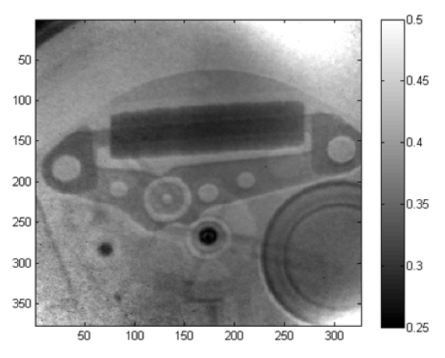
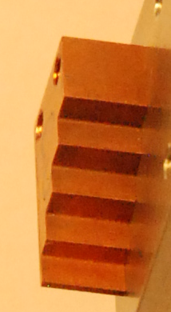
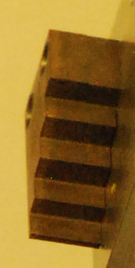
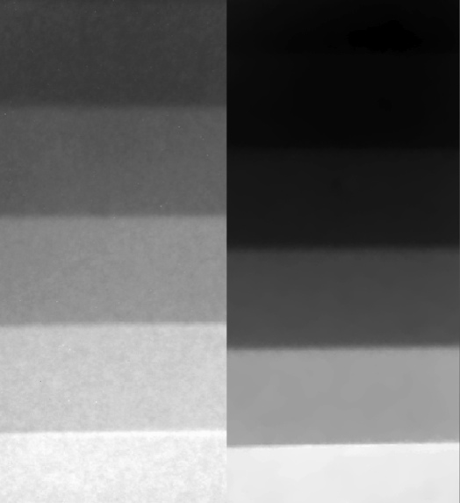
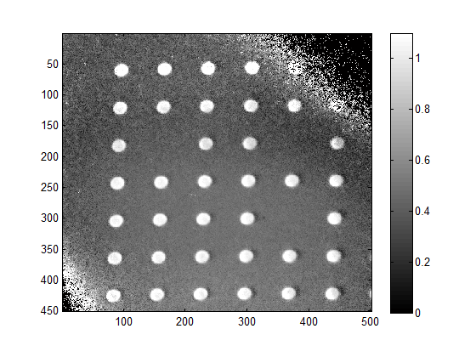
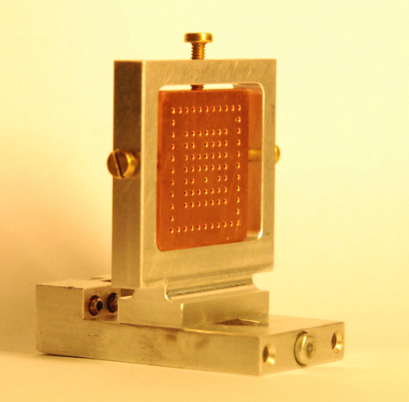
Static commissioning of PRIOR prototype
(April 2014, GSI, SIS-18, proton beam energy 3.6 GeV)
Quartz watch
Cu Ta
Plate is a 5 mm thick copper plate with 0.5 mm holes machined at 1.5 mm spacing.
Thickness of the steps are identical (0.56 mm, 2.06 mm, 4.07 mm and 6.05 mm)
Best spatial resolution of 30μm was obtained with
target - tungsten rolled edge with a radius of 500 mm
Notes:
Each PMQ lens consists of set of quadrupole magnetic modules, thickness of each module is 36 mm, aperture is 30 mm. Each module is two-layered structure consisting of separate trapezoidal sectors (magnetic elements) mounted in the metal casing (yoke). The modules are pulled together by a special stand, before installing to PMQ lens. Casings of PMQ lens are made of aluminum with holes and adjusting screws to adjust the position of the quadrupole modules. Aluminum casing of lens is mounted in bearings (allowing to rotate the lens assembly relative to the axis of the proton beam) associated with the adjusting stand. Length of bodies of two short PMQ lenses - 180 mm, long lenses - 360 mm. Basic parameters of PMQ lenses are shown. Effective length of short lenses (for the version of PRIOR setup capable for operating at GSI with the proton beam energy of 4.5 GeV) is 144 mm, long lenses - 288 mm. Quadrupole modules are installed in the casing of lens clamped by two alluminium spacers on both sides of the lens. Short PMQ lenses consist of four quadrupole modules, long lenses consist of eigth modules. Casings of PMQ lenses equipped with adjustable screws that allows adjust the position of modules at horizontal and vertical planes with the ability to change the angle of the module. Adjusting positions of the modules is very important to align the median planes of PMQ lens and set the position of the magnetic axis of each module on the mechanical axis of rotation and the axis of the proton beam.

Slide 15
Dynamic commissioning of PRIOR prototype
(underwater electrical wire explosion target)
Main goal: measure density distribution of internal structure of expanding wire
Water filled target chamber
Proton radiography images
of exploded Ta wire
Pulse power generator:
50 kV, 10 µF, 150 nH
250 kA,
2.5 µs (rise time)
12.5 kJ stored
Wire: 0.1-1 mm diam.,

Slide 16
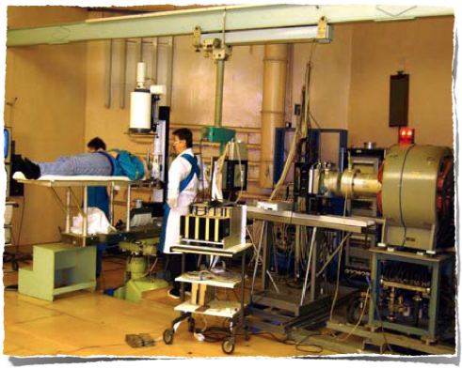
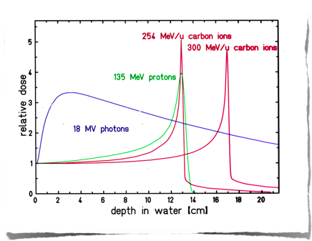
“Plateau” and “Bragg peak” radiosurgery
St.-Petersburg Nuclear Physics Institute (PNPI), Russia
Since 1975 a total of 1,362 patients treated

Slide 17
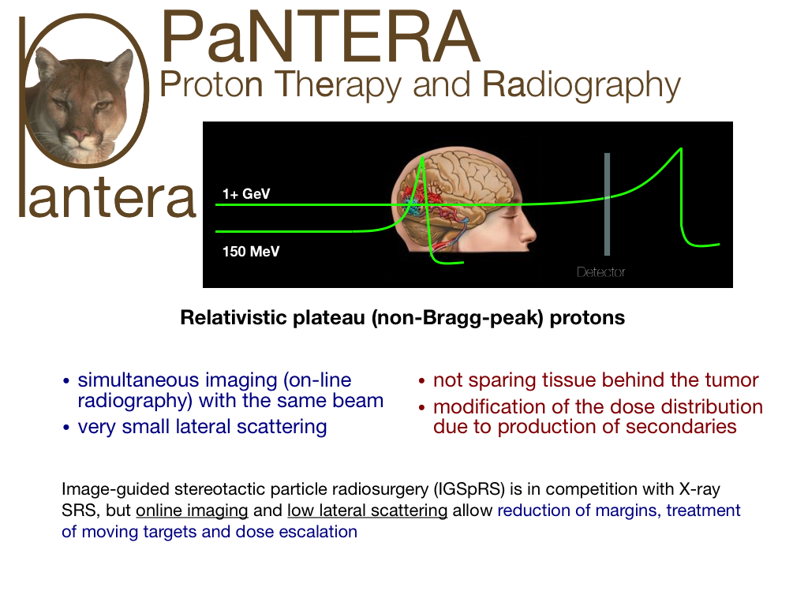
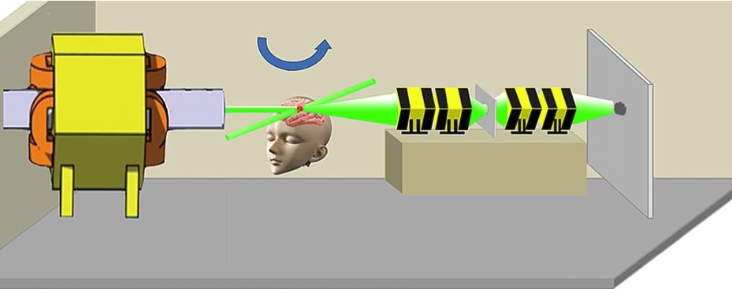

Slide 18
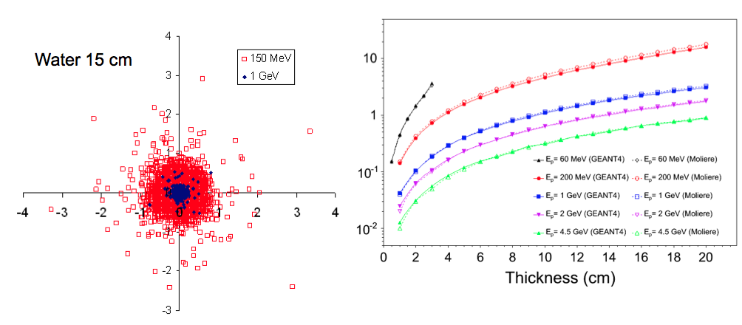
“Bragg peak” vs. “Plateau”: scattering and precision
SRIM simulation
FWHM (mm)
cm
Advantages with high energy protons and proton radiography:
Online imaging and low lateral scattering allow reduction of margins, treatment of moving targets and dose escalation
after 16 cm of water:
FWHM(150 MeV) ≈ 7.5 mm ⇒ cm-scale precision
FWHM(4.5 GeV) ≈ 0.4 mm ⇒ sub-mm precision

Slide 19
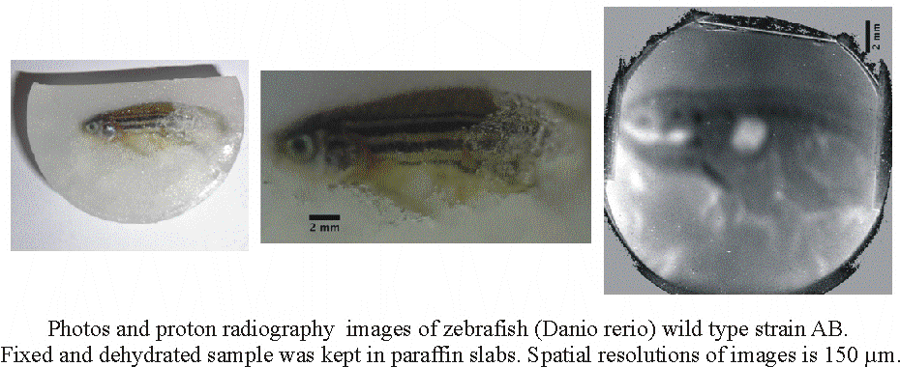
Experiment at PUMA proton microscope at ITEP
(end of 2011) 800 MeV protons
Static target for the determination of density and spatial resolution. Investigated object of Plexiglas PMMA with cylindrical holes of different depths (from 0.5 mm to 8.0 mm), and its image obtained by proton microscope PUMA at ITEP
D. Varentsov. ..,A. Kantsyrev et al. // European Journal of Medical Physics (Physica Medica).) 29, 2013, pp. 208-213

Slide 20
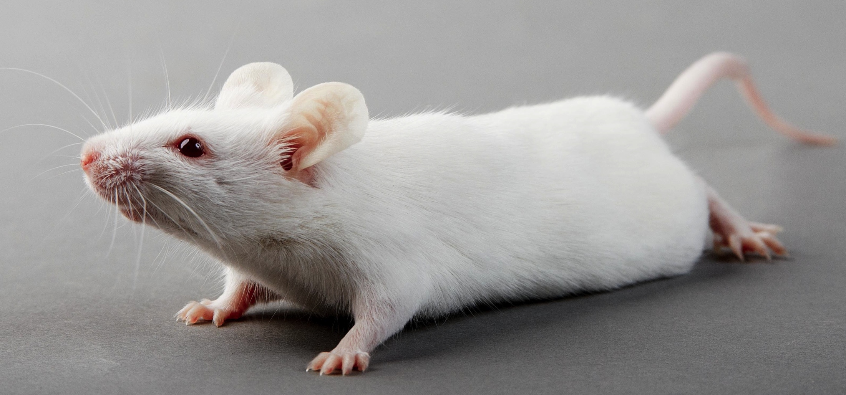
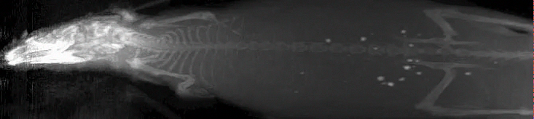
800 MeV proton radiography for tomography imaging LANL (2013)
Algebraic reconstruction technic (ART) for 3D reconstruction
Work was produced by LANL and GSI

Slide 21
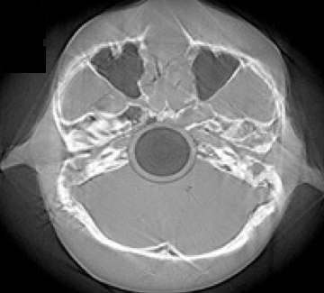
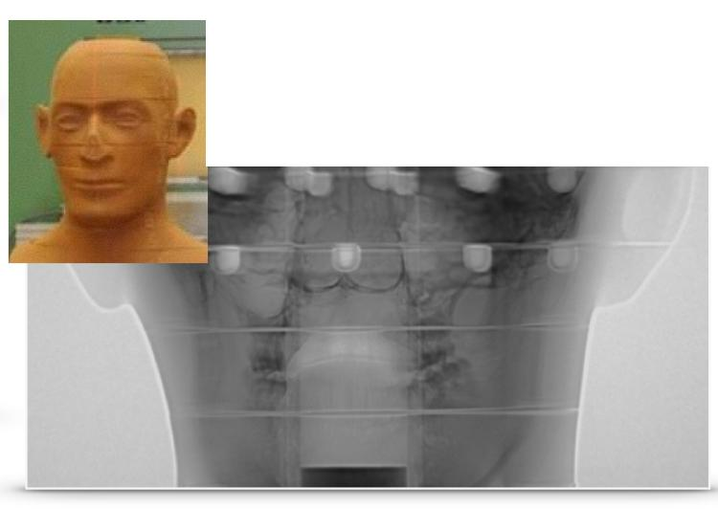
Biological images with 800 MeV HEPM of human phantom –
“Matroshka” LANL (2013)
Bony anatomy is clearly resolved with a dose of about Dimage ≈ 10 mGy
M. Prall et al. // Journal of Physics: Conference Series 599 (2015)

Slide 22
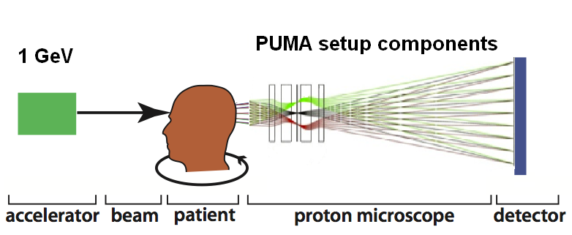
Possible setup at PNPI with 1 GeV protons

Slide 23
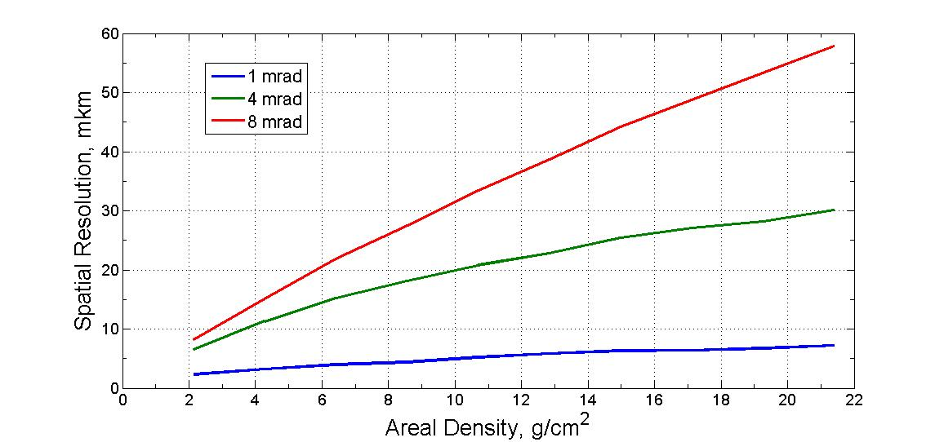
Possible setup at PNPI
(spatial resolution with PMMA target)

Slide 24
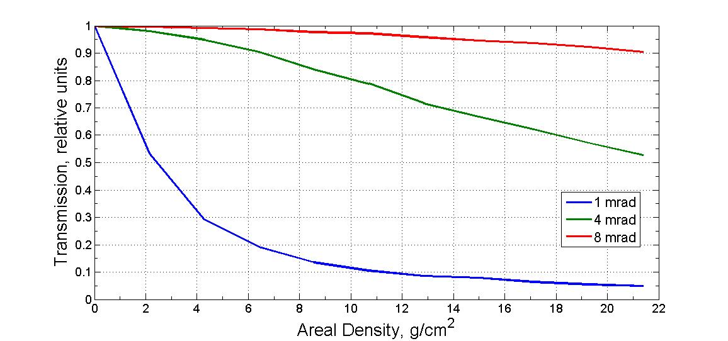
Possible setup at PNPI
(Density sensitivity)

Slide 25
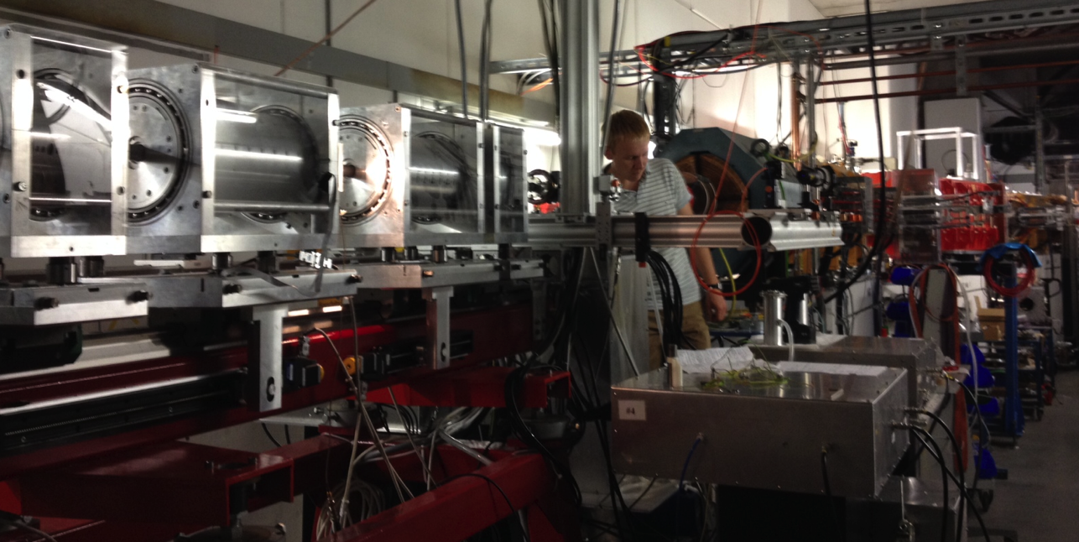
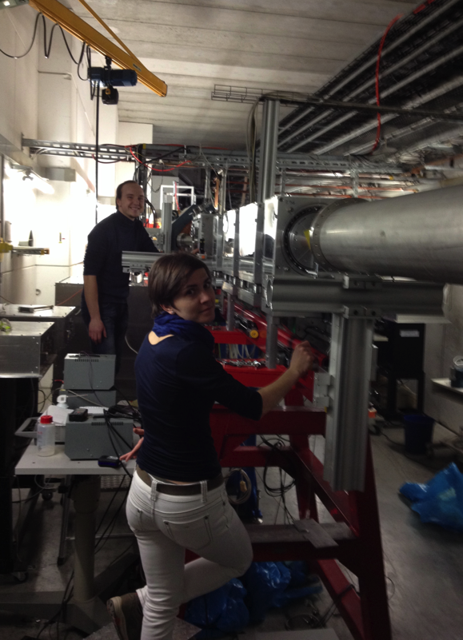
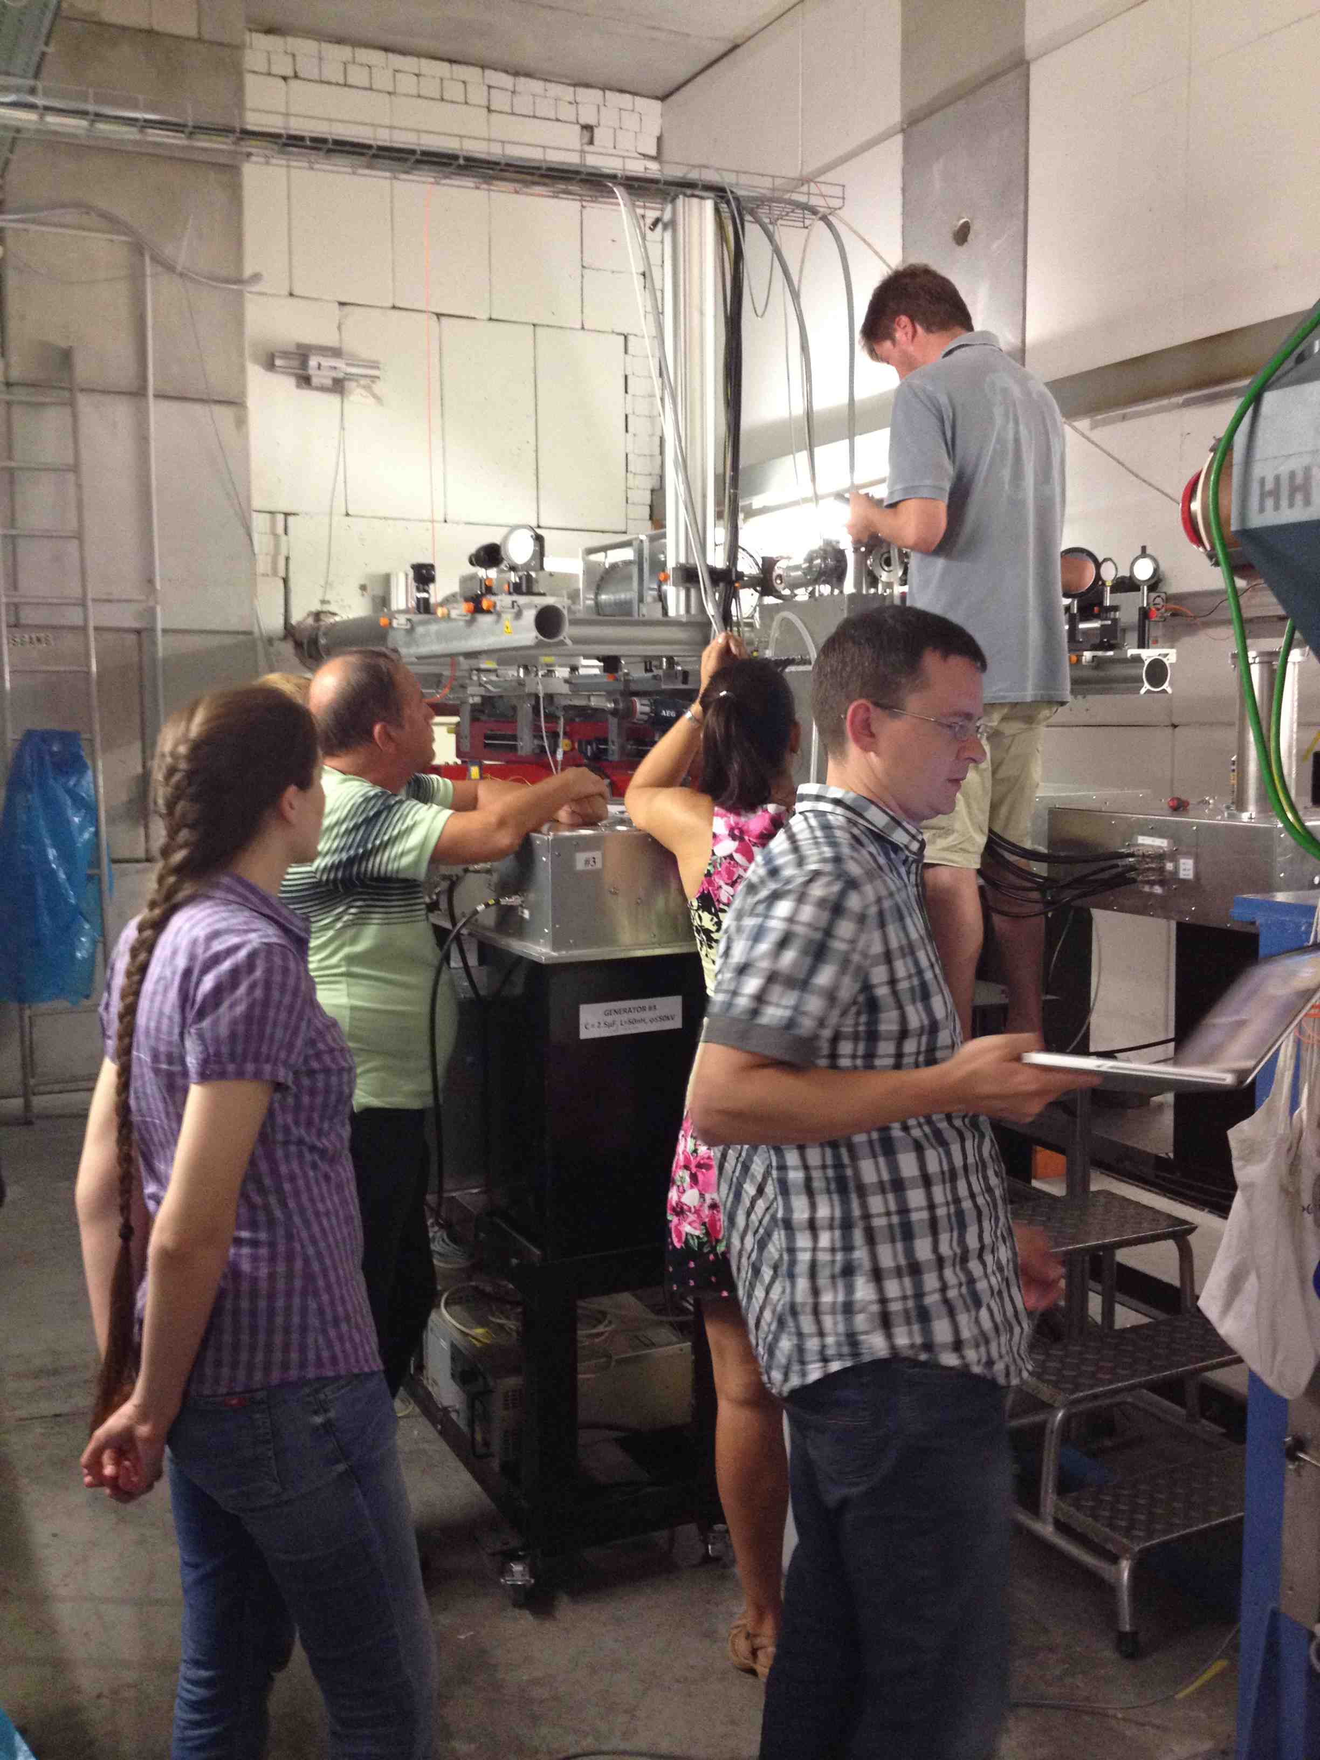

This work was supported by
FAIR Russia Research Center (FRRC)
Thank you for attention!

